Slide 1
Data Analytics Project
Name : Naveen C S,Ashay G,Bhargav V, Manoj Kumar P
SRN : PES1201801744 , PES1201801767 ,PES1201801796 ,
PES1201801923
Team Name : Elite Inferno CO2 Emissions

Slide 2
Project title
CO2 Emissions Due To Fuel Consumption

Slide 3
Problem Statement
The specific problem we are focused on the solving is the CO2 emissions due to light duty vehicles.We tend to train and calculate CO2 emissions the tailpipe emissions of carbon dioxide (in grams per kilometre) for combined city and highway driving through linear regression.
We have used data analytics tools to observe that here most car models emits CO2 in the rate of 250 which is likely to be eco friendly than higher rates.We have determined the factors affecting the CO2 emissions.We have used different different regression models and compared the accuracy and determined the best model to estimate the CO2.We have used data analytics tools to observe that here most models emits CO2 in the rate of 250 which is likely to be eco friendly than higher rates

Slide 4
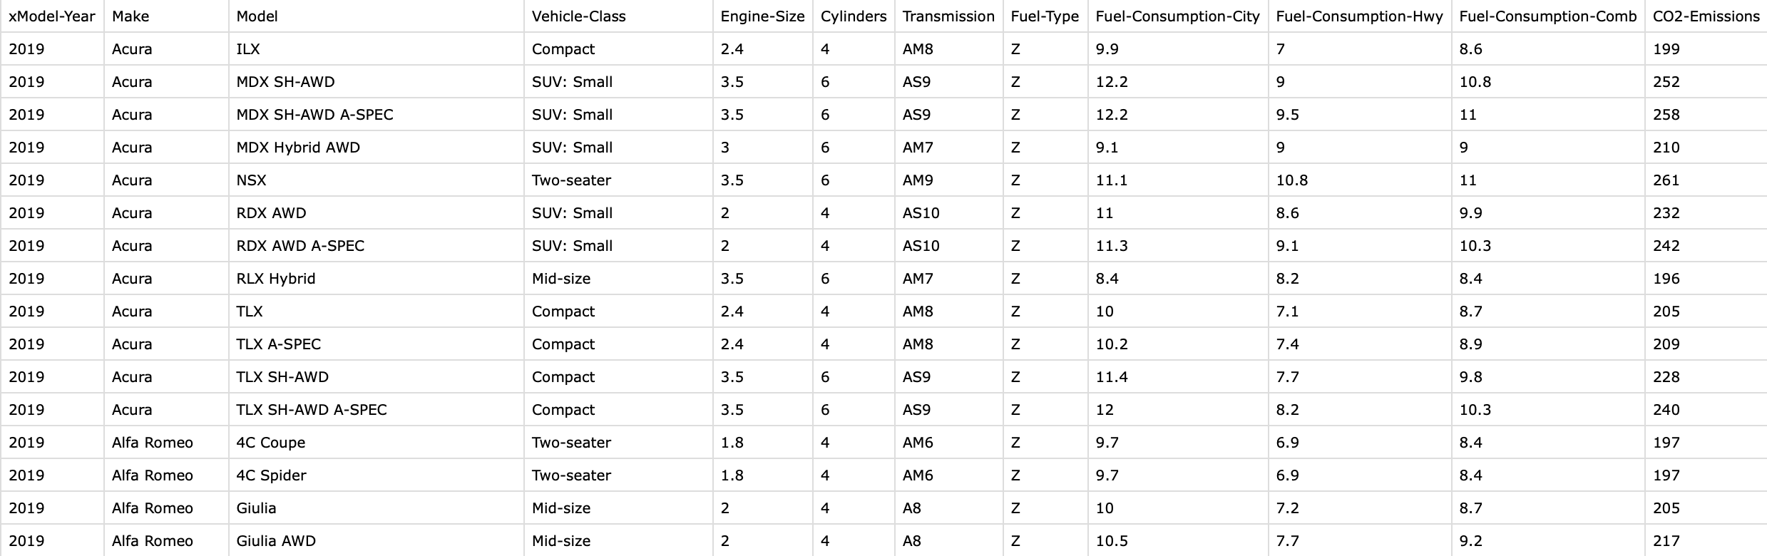
Data Set
Dataset provides model-specific fuel consumption ratings and estimated carbon dioxide emissions for new light-duty vehicles for retail sale in Canada for year 2019.
The data set contains 7 numerical values and 4 categorical values.

Slide 5
Importance of the Problem Statement
The major questions we answer through these projects like the CO2 emissions of the vehicles and calculating the CO2 through the features of the vehicles and comparing these calculations with different models. Through this we can decide the cars which are good for the environment. We can directly know the model of the cars which are well under that 250 mark that we desire.This is method is used in our project for regression and classification problem in out project. Through this project we intend to reduce the CO2 footprint on earth.Although we know that electric cars the future and leading the game in this field is Tesla but it is not to be forgotten that these fossil fueled cars not going anywhere in the near future.Due to this analytical study in carbon emission we can know the fuel consumption and the carbon emission of different vehicles.Through this as a future work we can try to develop automated system to recognize the emission of these vehicles and help them to fix this issue.

Slide 6
Solution Approach
Our solution to the problem statements has the following components
1. Pre processing
2. Building Models
3. Evaluations

Slide 7
1. PreProcessing
As a part of Preprocessing to our data we found no missing values.But we have found some outliers.We have removed the outliers as they will harm the data set.There were no inconsistent, incomplete, duplicate or incorrect data.Preprocessing contains techniques such as dimensionality reduction, range transformation, standardization.We have not done dimensionality reduction as all the dimensions aka attributes were important for the final machine learning models.
There is no range transformation as they were not required. Standardization was not done as a part of preprocessing but as a part of multilinear analysis this was done by de- fault.Principal component analysis(PCA) does not help in the visualization of data because we have not done any operations based on dimensionality reduction as all rows were important to the output.

Slide 8
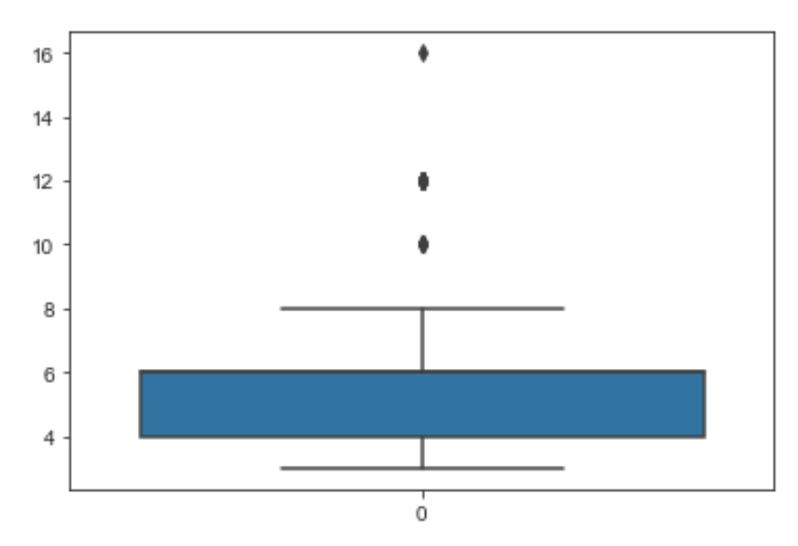
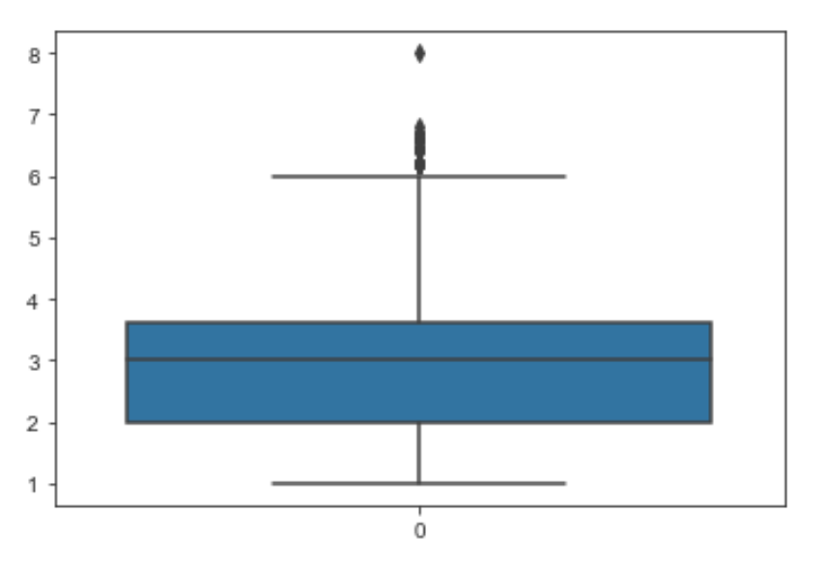
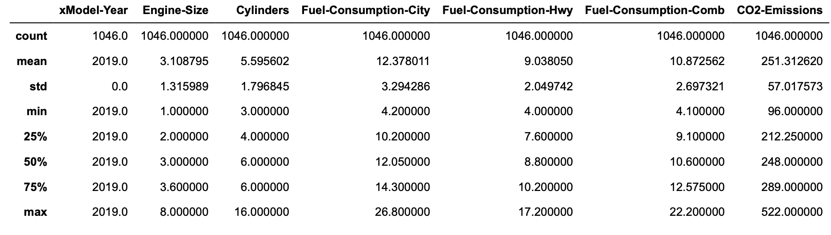
Detecting Outliers

Slide 9
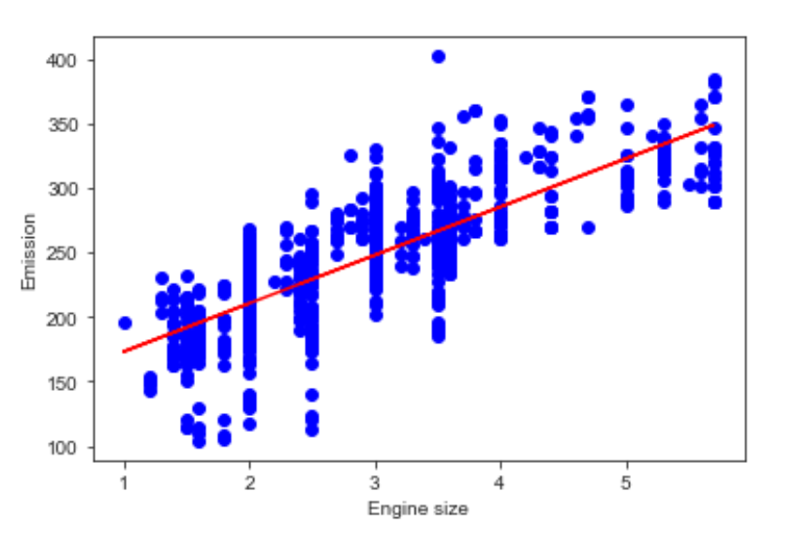
EDA and Visualizations
The scatter plots tell us that all the numerical attributes such as ’Engine-Size’,’Cylinders’,’Fuel-Consumption-City’,’Fuel- Consumption-Hwy’,’Fuel-Consumption-Comb’ are positively correlated with CO2 emissions.
‘Emission’ and ‘Engine Size’ are positively correlated

Slide 10
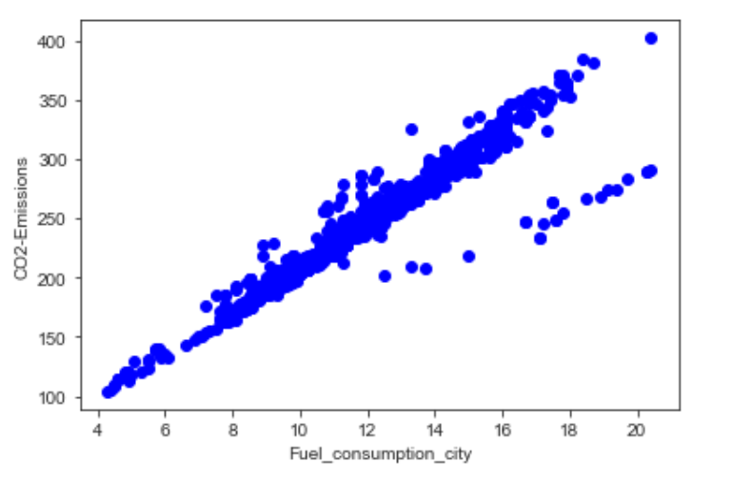
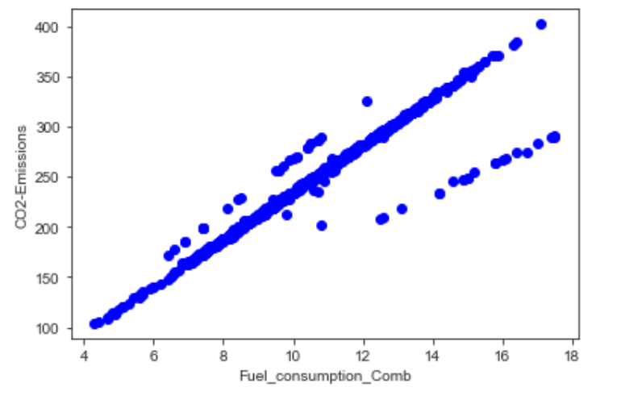
‘CO2-Emissions’ and ‘Fuel Consumption City’ are positively Correlated
‘CO2-Emissions’ and ‘Fuel Consumption Comb’ are positively Correlated

Slide 11
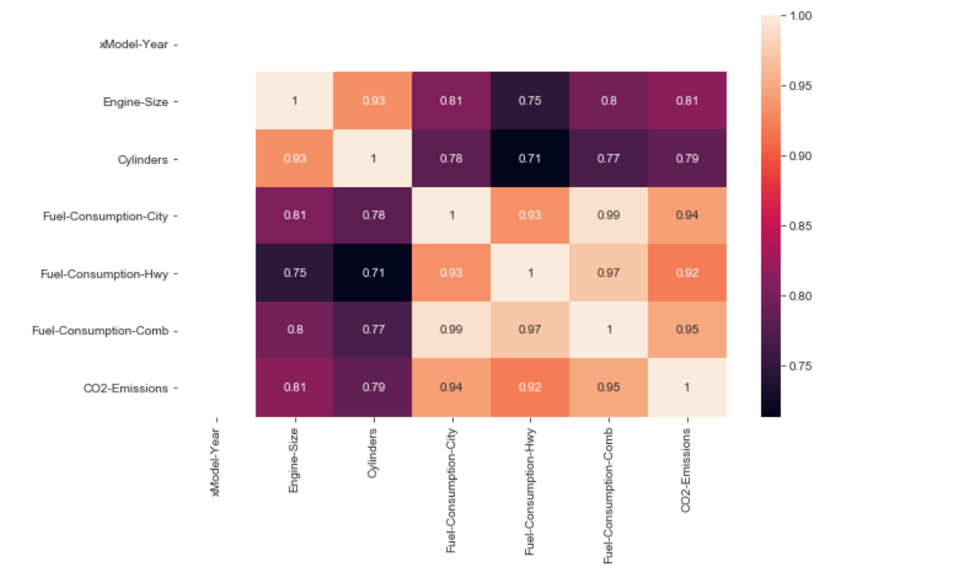
Heatmaps are utilized to show connections between two variables, one plotted on each axis. By seeing how cell colors change over each axis, you can notice if there are any examples in an incentive for one or the two variables.
The above heat map shows the relationship of different variable plotted against each axis.This a very good way to represent the relationship between the variables.

Slide 12
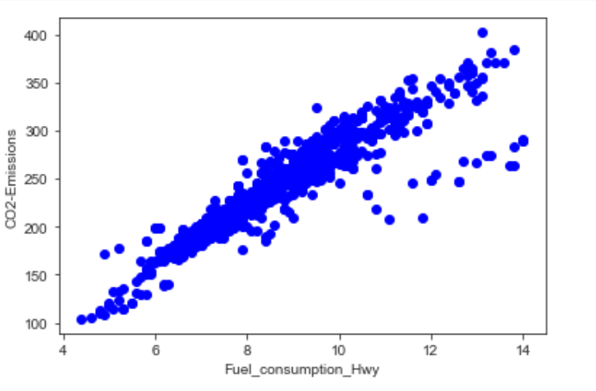
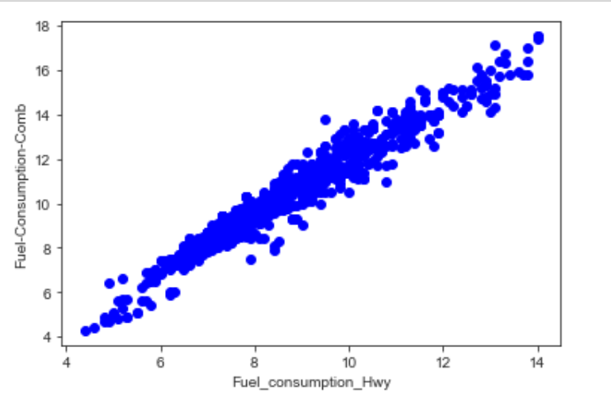
‘CO2-Emissions’ and ‘Fuel Consumption Hwy’ are positively Correlated
‘Fuel consumption comb’ and ‘Fuel Consumption Hwy’ are positively Correlated

Slide 13
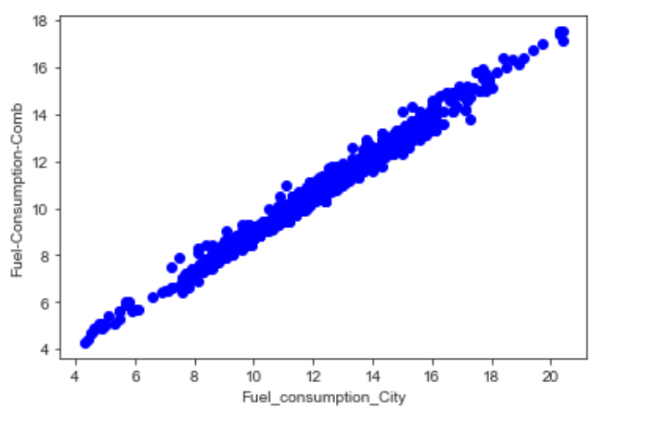
‘Fuel Consumption comb’ and ‘Fuel Consumption City’ are positively Correlated

Slide 14
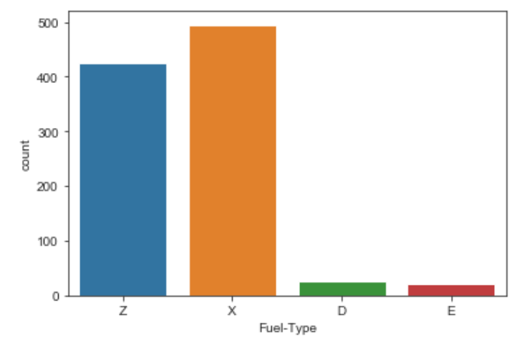
.
The plotted bar charts shows that most of fuel type is found to be X and Z.

Slide 15
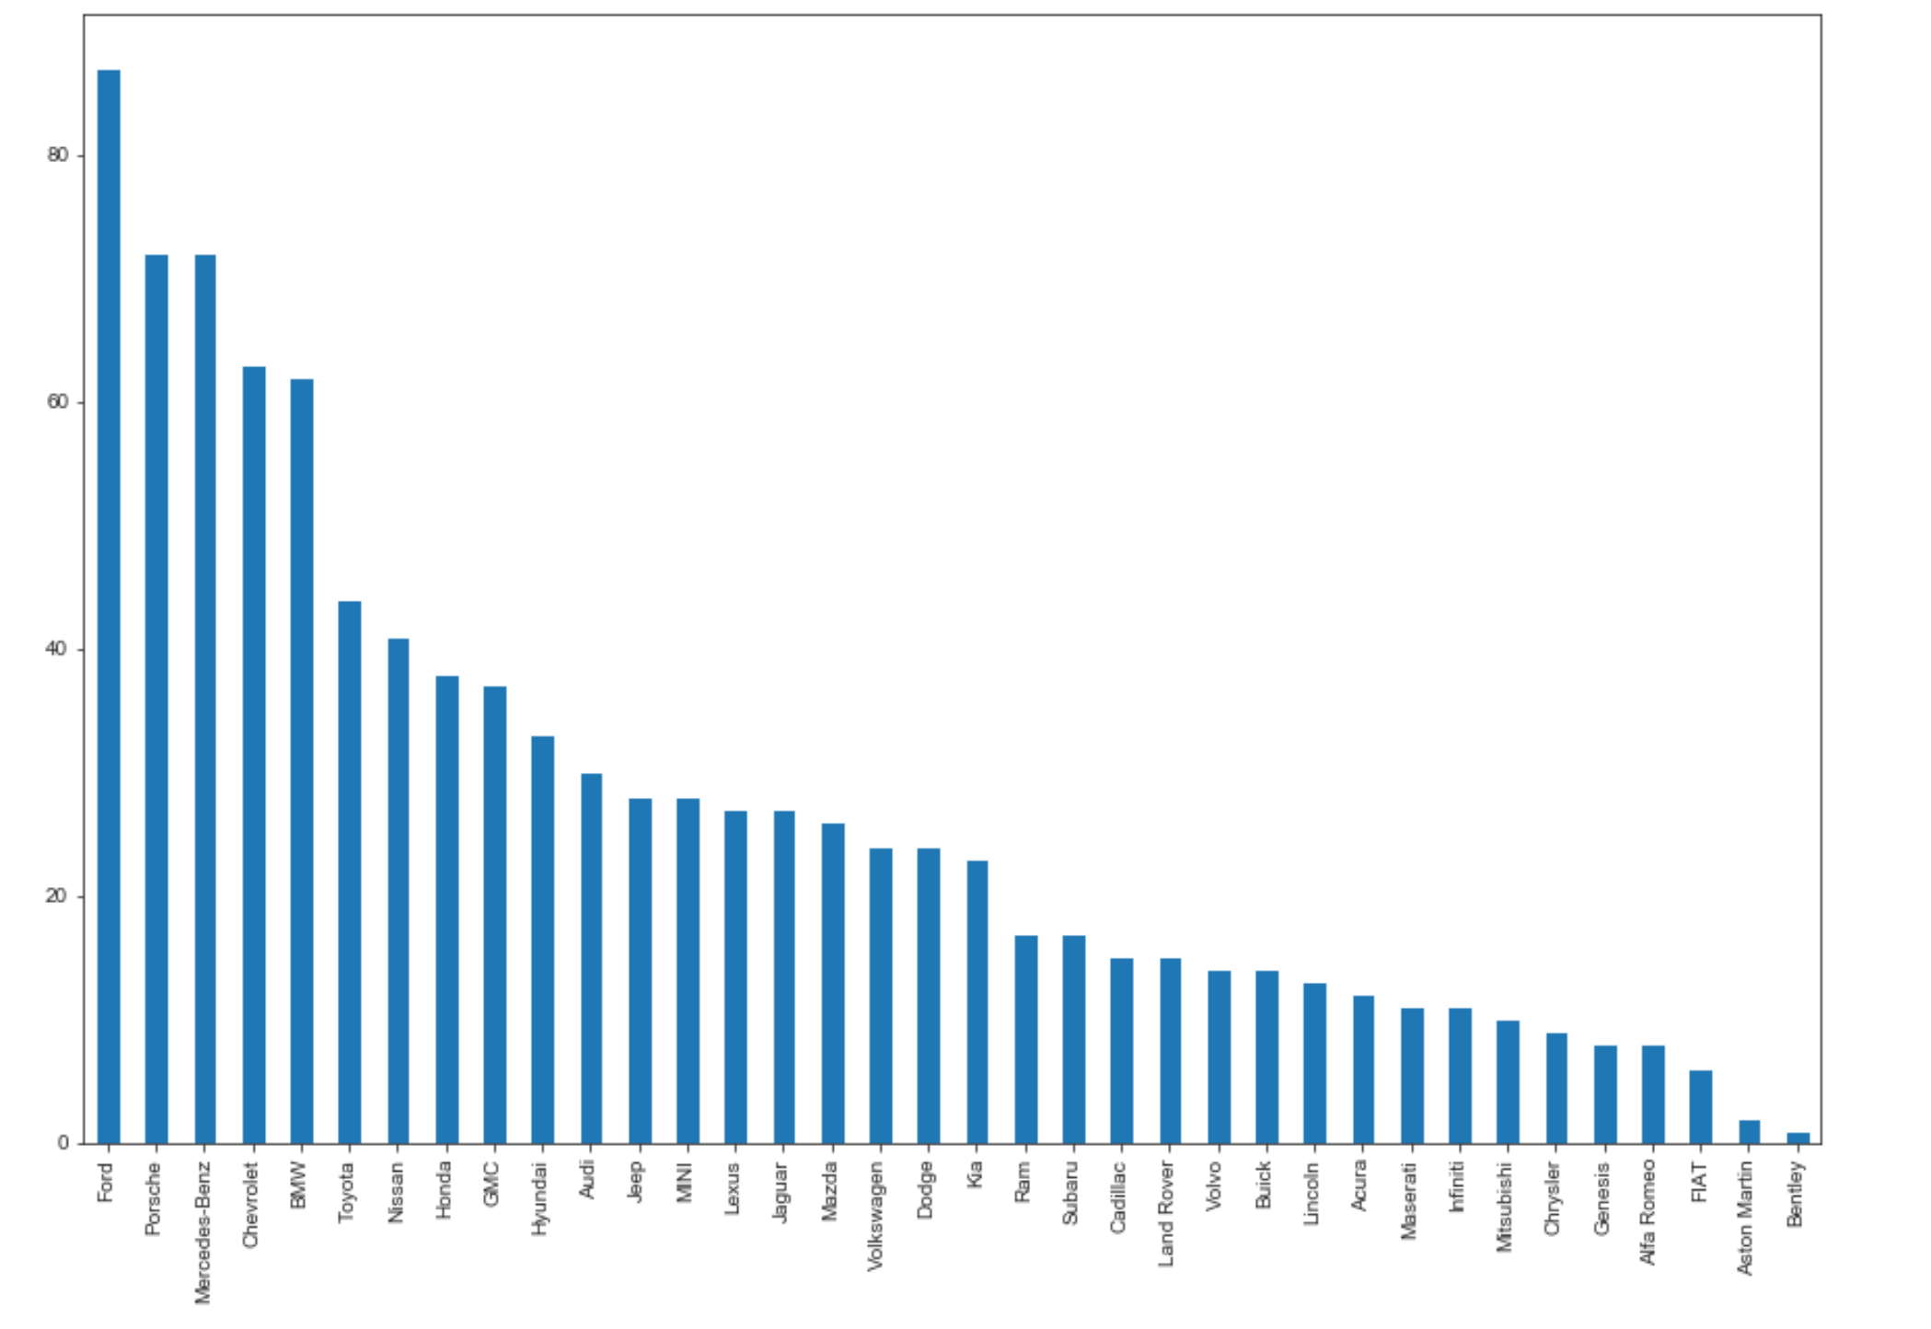
The bar plot give the number of cars of each company in a pattern which is decreasing order.

Slide 16
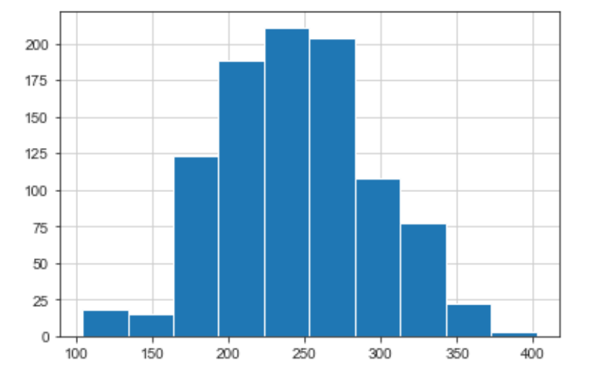
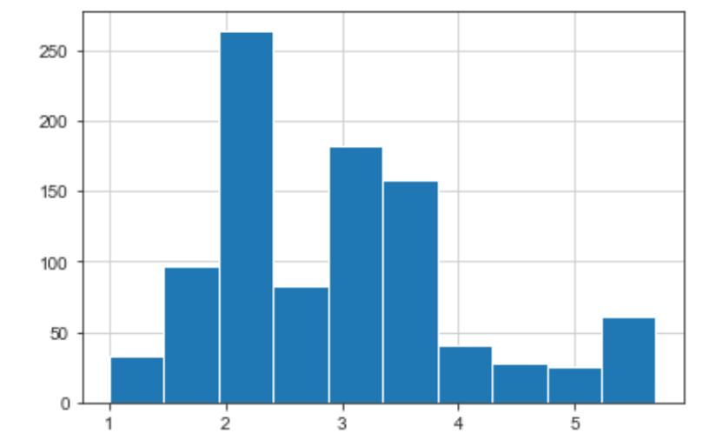
From this histogram we observe here that most models emits CO2 in the rate of 250 which is likely to be eco friendly than higher rates. We should try to reduce to even better than this achieve eco friendly nature by finding out the necessary correlations where CO2 emissions should be at a certain minimum rate.
We can observe here that most of the models engine size lies between 2 and 3 units

Slide 17
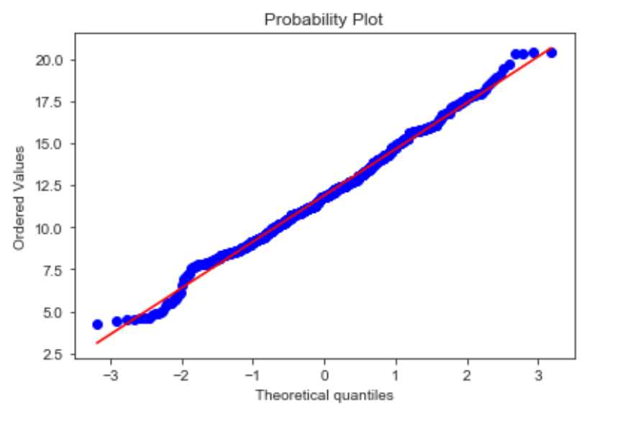
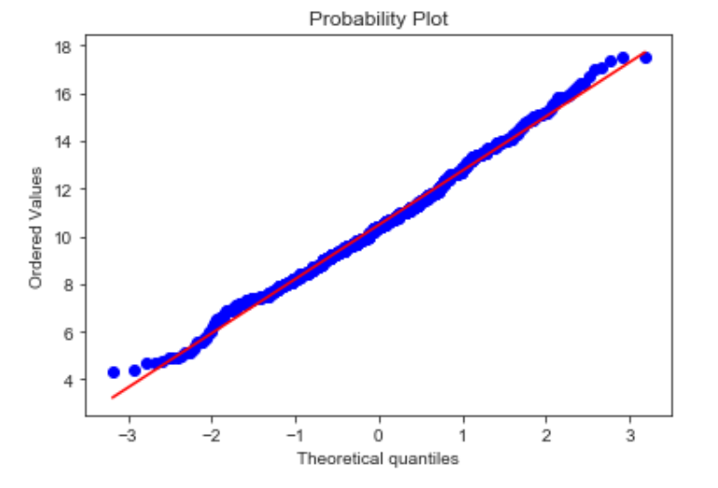
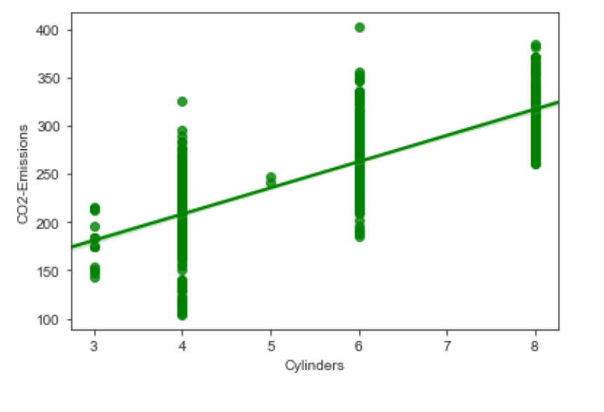
All data are in normalized from and this is known through these probability plots
These are plotted to distin- guish a line between 2 parameters and helps to visualize their linear relationships.

Slide 18
2. Building Models
We have used the regression models to build and predict the CO2 emissions based on the training given to the training set. Most of our models and predictions are done using the libraries like scikit learn .We have used the scikit learn in the pre processing for splitting the data into the train test split. Since the models we have used the regression to predict out the continuous values of CO2 emissions we have discarded the categorical attributes which do not have much correlation with the CO2 emissions.
which is most popularly used for building the models like
1)Multiple Linear Regression
2)Decision Tree Regression
3)Polynomial Regression
4)Random Forest Regression

Slide 19
Multiple Linear Regression:
In the multiple linear regression firstly we have split the dataset into the train test so that we can test with some part of the data within the dataset. Here we have the built-in linear model called LinearRegression imported from the module sklearn. We are going to fit the data which is to be trained and would give insights to the model and predictions so that when it is given a test data without the target variable it should be able to predict the output based on the trend the model has followed from the training dataset. In general terms the independent variables should be able to predict out the results of the target(dependent variables). R2 score is like a test for the accuracy where we can check out the proportion of correctly predicted to the total number of predictions.

Slide 20
Decision Tree Regression:
Firstly we are interested in splitting up the dataset into the train test dataset that helps in testing the predictions inside the dataset. Here we have a built in model called the Decision Tree imported from the module sklearn.tree. We are going to fit the data which is to be trained and give insights of the model and predictions so that when it is given a test data without the target variable it should be able to predict the output based on the decision taken from the decision tree. Decision tree not only does the predictions based on the classification but also based on the regression which imports a module from the sklearn. R2 score is likely to test for accuracy where we can check out the proportion of the test data to the total data.

Slide 21
Polynomial Regression:
Using the scikit learn we are going to do these two steps of adding polynomial features and applying linear regression to it in a pipeline. Polyfit is performing a univariate polynomial fit for some vector a to some other vector b. We have performed the polynomial expansion of the feature X-train represented in a higher order polynomial terms for the multivariate fit. Basically in this model we are transforming the X-train to the n degree polynomial where n is the number of independent variables(continuous attributes) using the function in scikit learn called fit-transform(). After transformed it into the polynomial feature we have applied fit so that it can fit with the output training data. Then we have tested the test split using the above built polynomial regression with the test data. Applying the same transform and fit function to the test split and computing the accuracy compared to the polynomial featured trained data.

Slide 22
Random Forest Regression:
Using the scikit learn i.e sklearn.ensemble we are importing RandomForestRegressor. We are calling the RandomForestRegressor with the first argument being the number of forest in the random forest and assigned it to some variable. We will be applying the fit with respect to that variable which has RandomForestRegressor is been called. After fitting the model we have to find the same with the test data and have to find the r2 score(accuracy of test data with respect to train data) and also MSE. Same as for the other models we are interested in predicting the higher accuracy between the train and test data and low MSE.

Slide 23
3. Evaluations
We have constructed four different machine learning models related to our dataset and tried to find the best model that would best testand split data from the train data. We have found out two parameters to have comparisions between the models: r2 score and Mean Squared Error(MSE). The model with the highest r2 score and the lowest MSE is the best model.
Based on the results obtained from the above model, we have got the higher r2 score and the lower MSE is for Multiple Linear Regression(MLR)[r2 score:0.9996494557501069, MSE:0.0014] is assumed to be the best model for our dataset to perform testing of new data with the similar kind of scenario or for a source based on our dataset given.

Slide 24
Inference on the Data and Learning in the process
Through this project we learnt lot on research paper writing.This also made us a lot more familiar with the concepts and understanding on data analytics.We learnt the use of overleaf and IEEE Format of writing papers.
This has been a wonderful experience through out from bengining to the end.We learnt a lot of things about machine learning
models especially.we also learnt how much harm we are to nature vai transport means . this thoughts will help us to move to less toxic or eco-friendly ways of transport.

Slide 25
Role of each team member
Literature review + initial solution approach : Paper1 was done by Bhargav V and second paper was done by Ashay G and third paper was done by Manoj Kumar P
The research paper was collectively by all members of the team.The solution approaches to the problem was also equally contributed by the team.
Ashay G and Bhargav V :
Model design and testing - Design model/ refine model parameters - Run cross validation tests and make a note of the results
- Run comparisons, test any other models that need to be tested Wrap up the model building/ testing and work on presenting and interpreting results.
Manoj Kumar P and Naveen C S :
- Preprocessing of data - Exploratory data analysis(EDA) and Visualization
- Preparing other materials for the project and Recording the video.

Slide 26
Thank You

